Slide 1


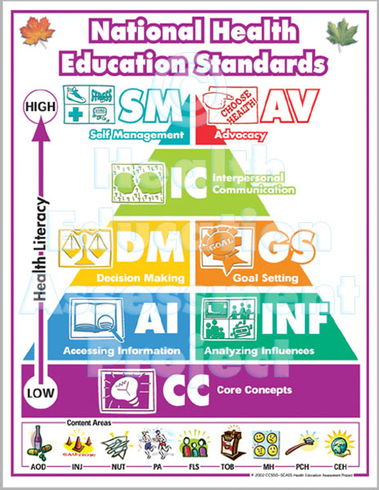
Health
Education
Registration Information

Slide 2
What are the courses?
Health 10
  Required for graduation
  1 trimester = 0.5 credit
Healthy Living I & Healthy Living II
  Elective course (Prerequisite: Health)
  1 trimester = 0.5 credit
  2 trimesters (for a total of 1 credit)

Slide 3

WHAT DO WE LEARN & DO?

Slide 4
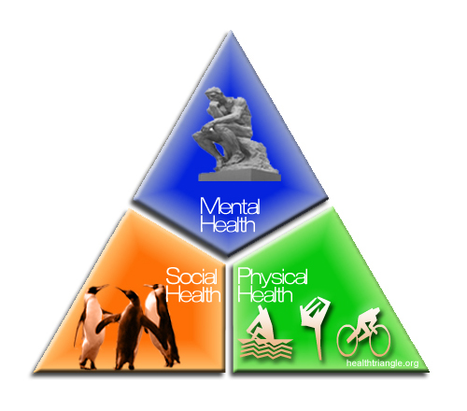

Intro to Health
Current Health Data
Health Triangle
Decision Making
Goal Setting

Slide 5
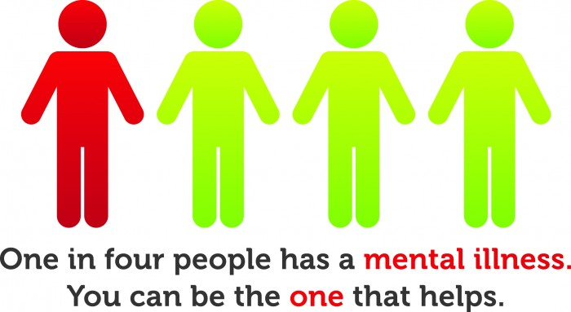
Mental Health
Self-Esteem/Image
Stress/Anxiety
Depression
Suicide
Grief
Mental Disorders

Slide 6
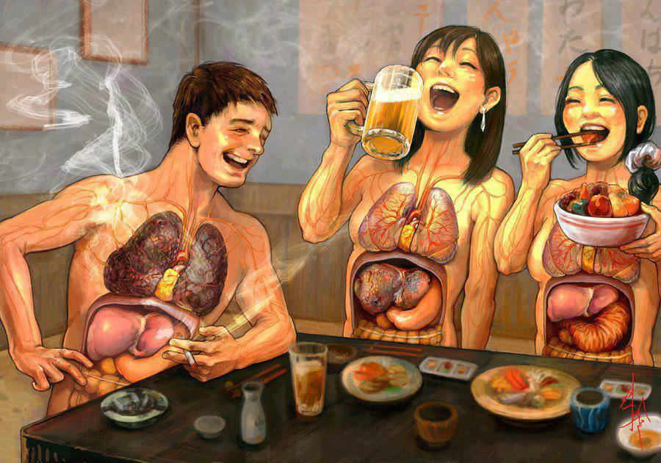
Lifestyle Diseases
GROUP WORK STUDYING THE FOLLOWING
Heart Disease
Stroke
Cancer
Hypertension
Diabetes
Arthritis
Emphysema
Can you spot the differences in the people’s insides?

Slide 7
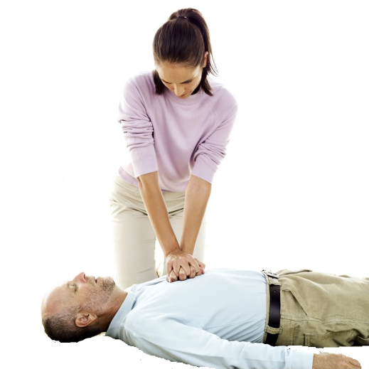
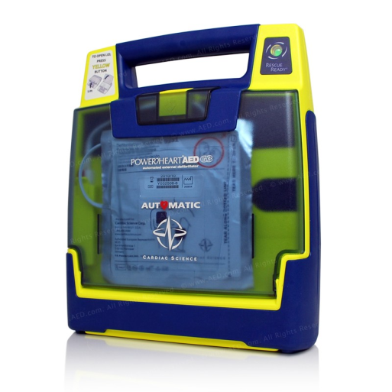
CPR
Adult, Child,& Infant CPR
Correct use of an AED(automated external defibrillator)
How to help a choking person
All students will be able to become CPR certified for two years following completion of this unit!

Slide 8
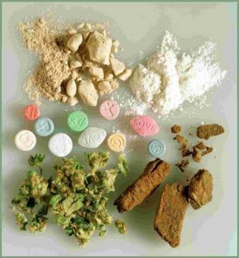

Chemical Health
Group work covering the most commonly used and abused drugs among teens
  tobacco, alcohol, marijuana, OTC drugs, and many other common illegal drugs.
Facts and statistics about the drugs and how they affect your body
Various types of addictions,
Peer pressure
Refusal skills, and how we can educate others about the negative effects of these drugs.

Slide 9
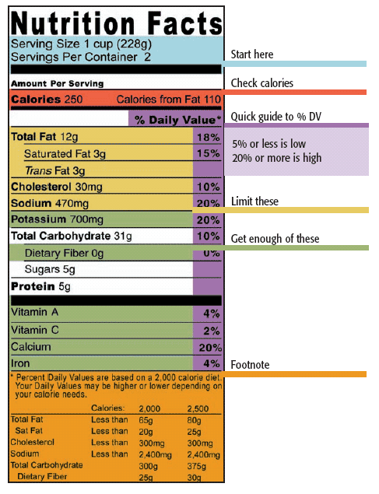
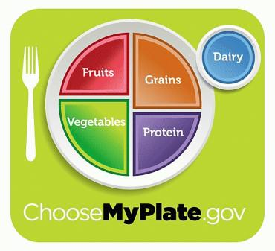
Nutrition
Nutrients
Dieting
Eating Disorders
Understanding a Food
Label
Personal nutritional
assessments using
ChooseMyPlate.gov

Slide 10
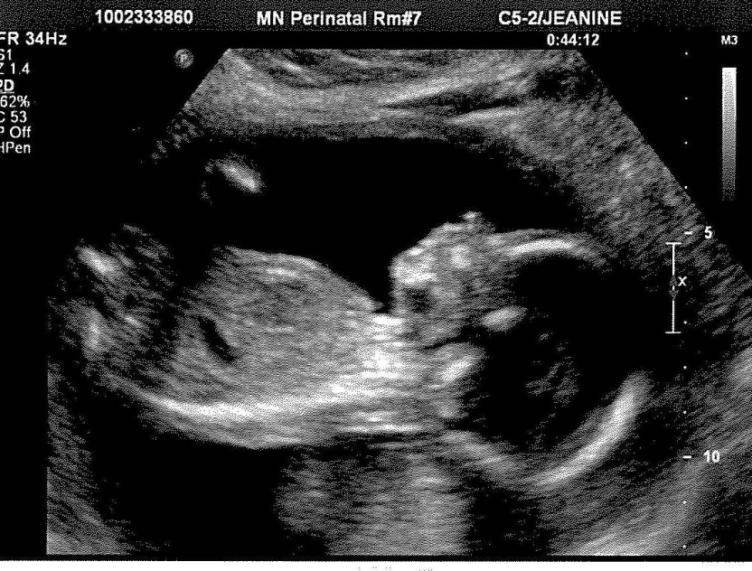
Sexual Health
Focus on Abstinence
Reproductive System
STD’s/STI’s
Family Planning
Pre-natal growth & development

Slide 11




Guest Speakers

Slide 12

WHAT DO WE LEARN & DO?

Slide 13
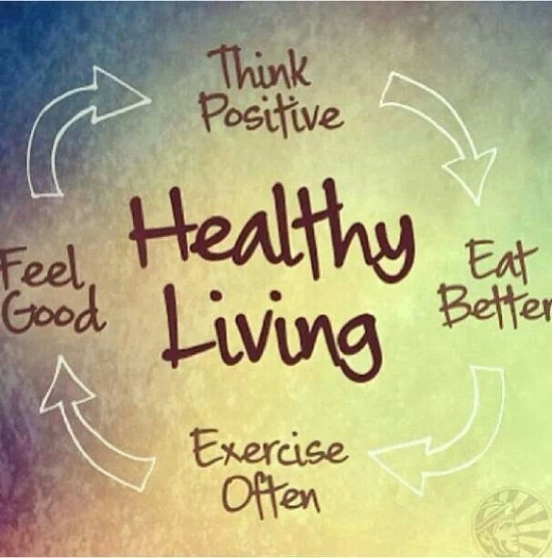
Healthy Living I
Intended Audience: Grades 11 and 12
Major Outcomes:
  Understand the connection between diet and fitness and the disease rates in America
  Understand the major vitamins and minerals and their effects on the body
  Understand the connection that lifestyle choices have on obesity and diabetes through personal fitness goals and implementation.

Slide 14
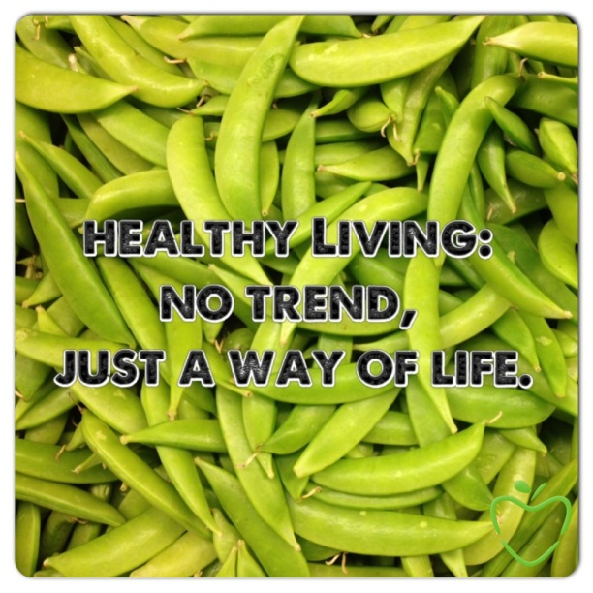
Healthy Living II
Prerequisite/Selection Process: Healthy Living I
Major Outcomes:
  Understand the connection between diet and fitness and the disease rates in America
  Understand the major nutrients and their effects on the body
  Understand the connection that lifestyle choices have on obesity and diabetes through personal fitness goals and implementation.

Slide 15
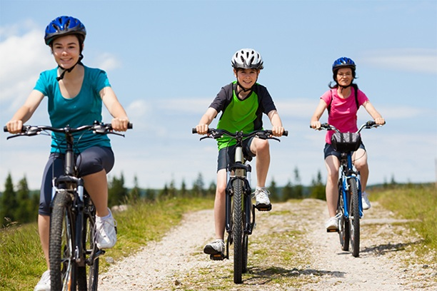
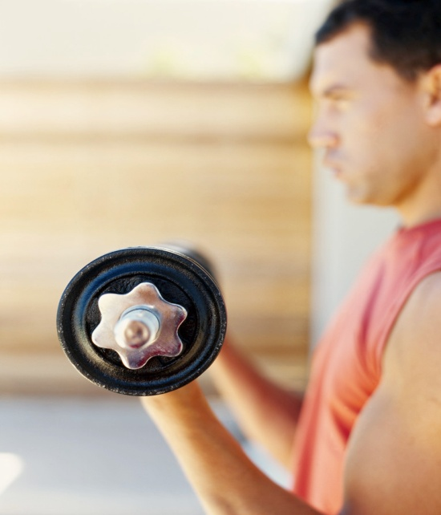
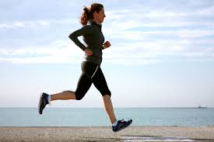
FITNESS
Biking on Bunker Lake Trails
Rollerblading
Weight Lifting
Walking/Running
Personal Fitness Plans
Other Games/Activities

Slide 16

Nutrition
Research Essential Nutrients
Group work on vitamins and minerals
Focus on what foods do to the body
Caloric intake vs Caloric outtake

Slide 17
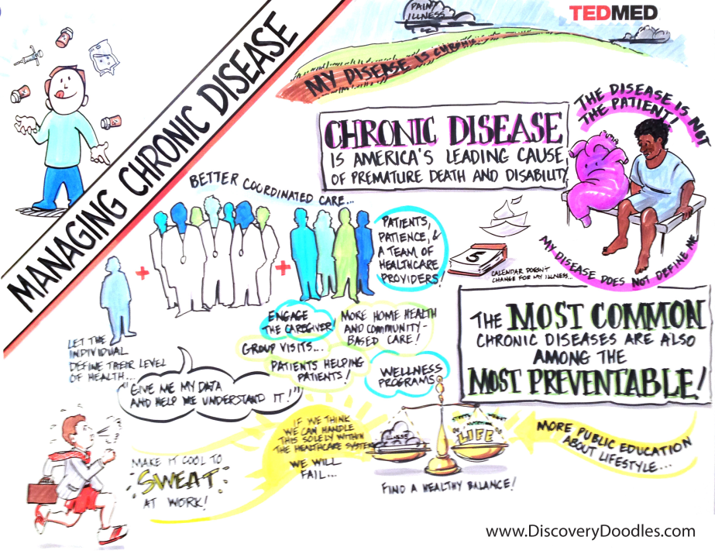
Diseases
Non-Communicable Diseases
Communicable Diseases
Group projects where students present to their classmate about the risks.

Slide 18

CLASS STUDIES
Importance of sleep
Importance of drinking water
Vitamins and Minerals
“What would you do?”
Fad Diets
Eating Disorders

Slide 19

Mental Health Studies
Depression
Stress/Anxiety
Communication
Eating Disorders
Healthy Relationships
Mental Disorders

Slide 20
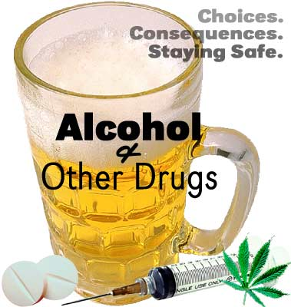
Chemical Health
Effects on the body
Effects on the brain

Slide 21
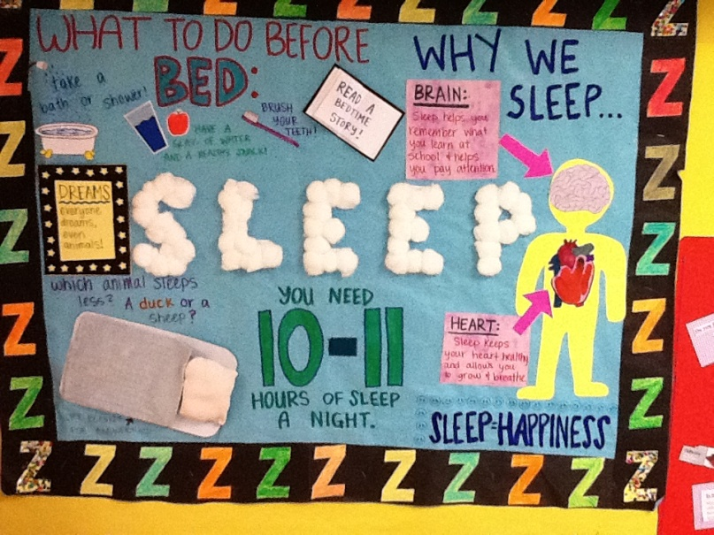
HEALTH PROMOTION
Community Service Projects
Bulletin boards
Public Service Announcements
Field Trips
Guest speakers on health topics

Slide 22
Public Service Announcements Examples
Teen Drinking
Fast Food
Cheating

Slide 23

SELF IMPROVEMENT
Goal Setting
Journaling
Book Study “Want Fries with that”
Book Report – Student choice

Slide 24
HEALTH FAIR
Choice of topics
Creative displays including:
  -Newsletters
  -PowerPoint's
  -Posters
  -Brochures
  -Web pages
  -Videos

Slide 25
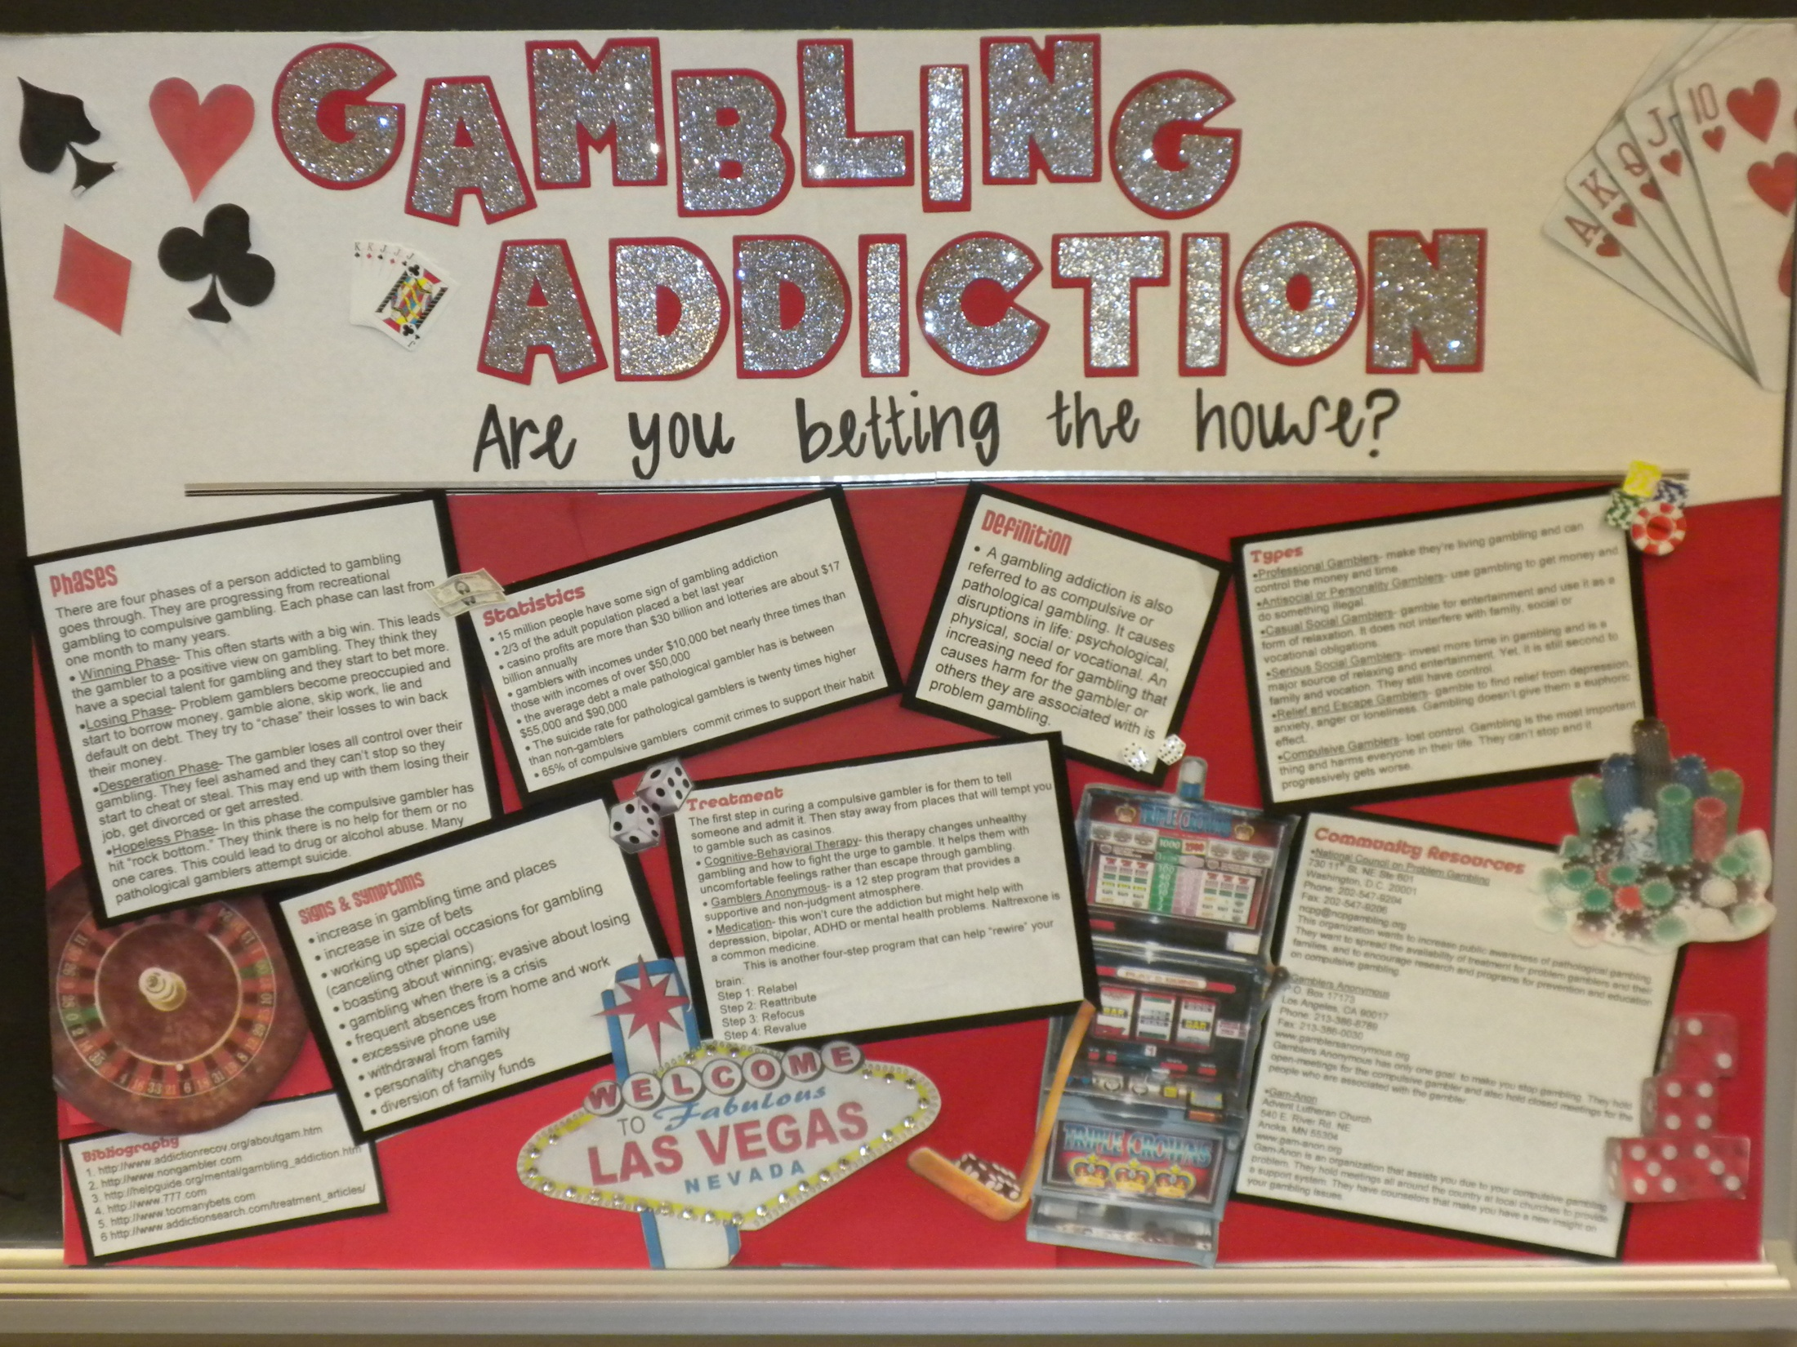
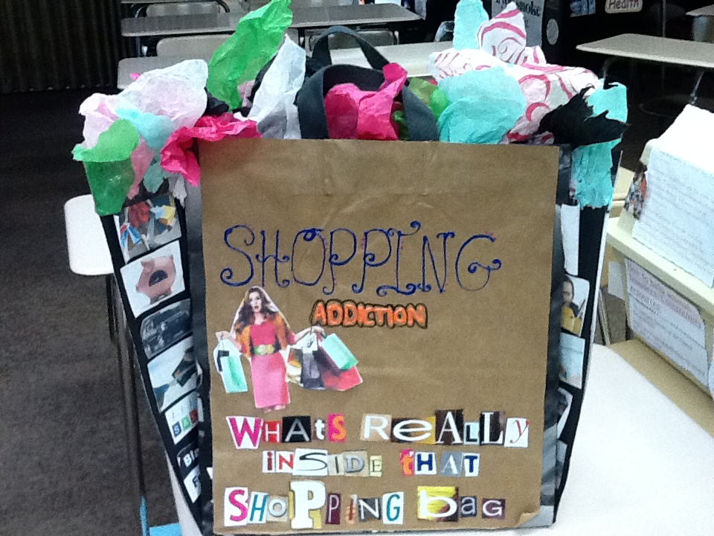
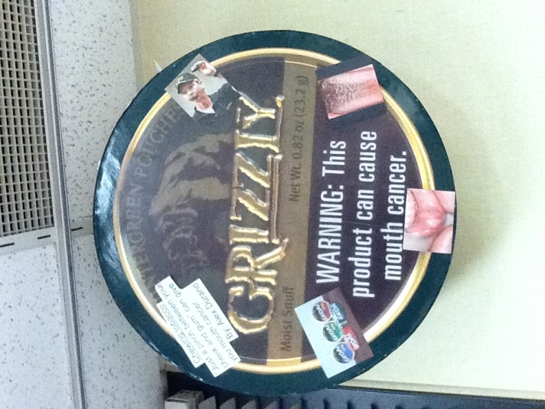
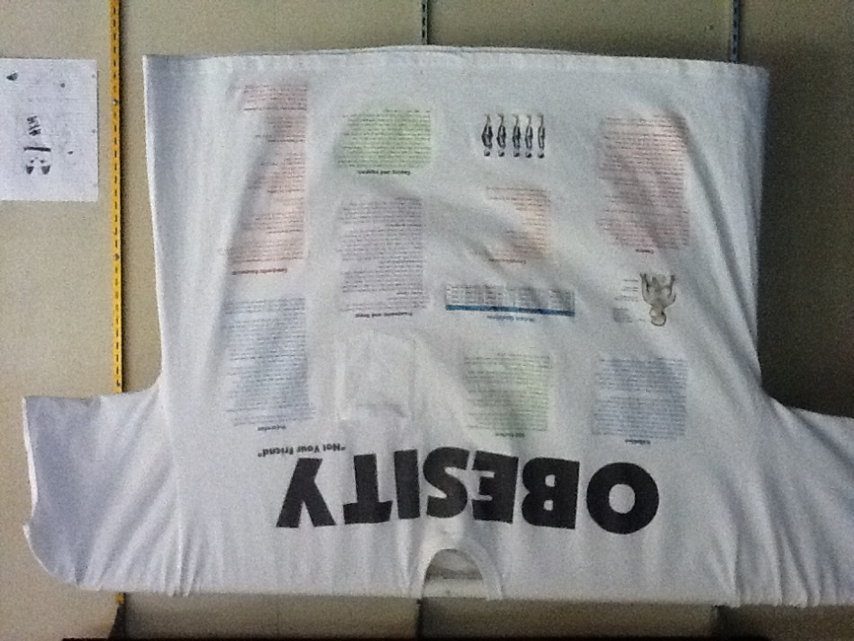
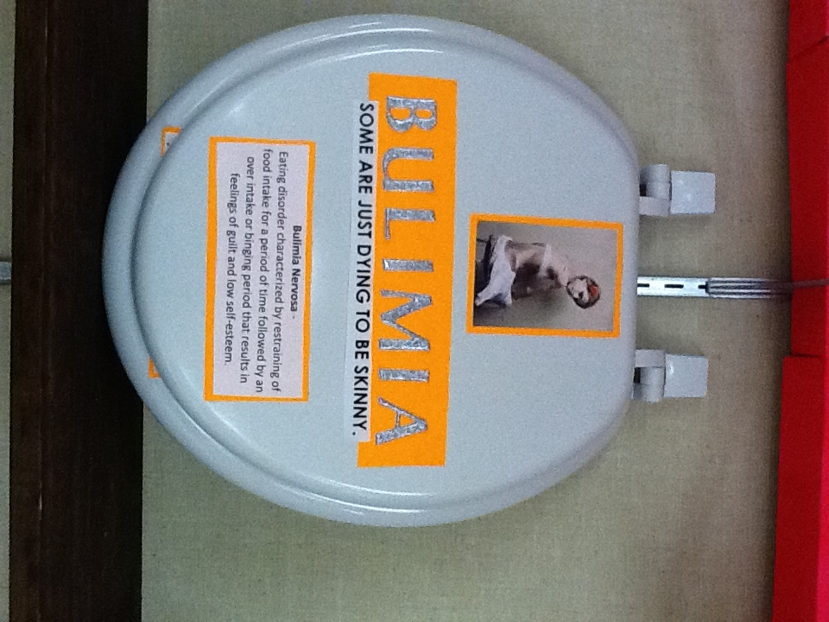
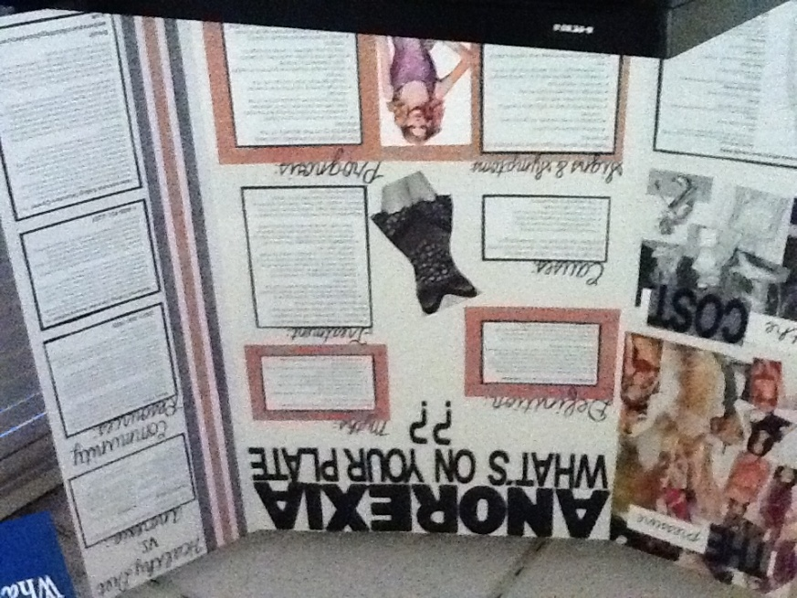
Health Fair Examples

Slide 26

Health
Education
Teachers
Mr. Richards
Mrs. Ries
Ms. Hornseth

